Slide 1
Confidence & Humility
Soft Skills
Notes:
Instructor:
Read through the whole lesson (including all the notes) before the day of class
Make note of and gather any supplies you need to bring
Prepare examples, stories
Think through how much time you want to spend on individual activities; make notes
Be sure to allow time to announce the assignment at the end
Overview:
Intro (slides 1-2): 3 minutes
Confidence (3-15): 15 minutes
Humility (16-21: 10 minutes
Balance (22-30): 20 minutes
Total: 48 minutes

Slide 2
Review
Learn several terms to help us discuss personality
Interpret three parables of personality
Experience others’ viewpoints
Understand methods to improve empathy and understanding
Notes:
What did we discuss last time?
Outcomes from lesson 14

Slide 3
Outcomes
Explore the concept of confidence
Explore the concept of humility
Discuss the balance between the two concepts
Self-assess your place on the Humility-Confidence spectrum

Slide 4
Confidence
ACME Seminar
Notes:
Overview:
Intro (slides 1-2): 3 minutes
Confidence (3-15): 15 minutes
Humility (16-21: 10 minutes
Balance (22-30): 20 minutes
Total: 48 minutes

Slide 5

Poll
What is confidence?
On your own, prepare a 1-2 sentence definition
Notes:
Image from https://static.pexels.com/photos/27452/pexels-photo-27452.jpg (CC0 license)

Slide 6
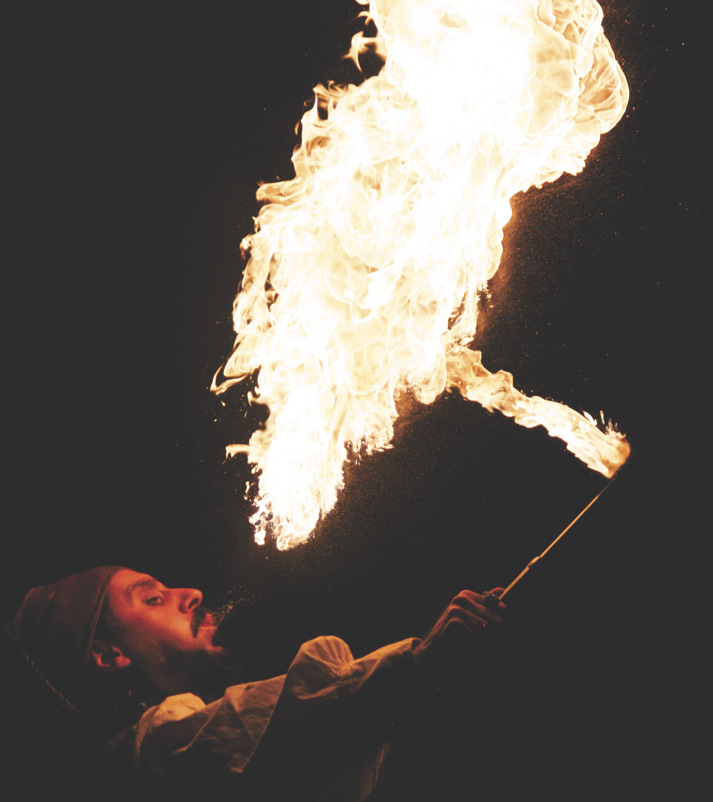
Share
In small groups, share your definitions (2-3 minutes)
Discuss the following:
What is confidence?
What isn’t confidence?
Notes:
Image from https://static.pexels.com/photos/69894/pexels-photo-69894.jpeg (CC0 license)

Slide 7

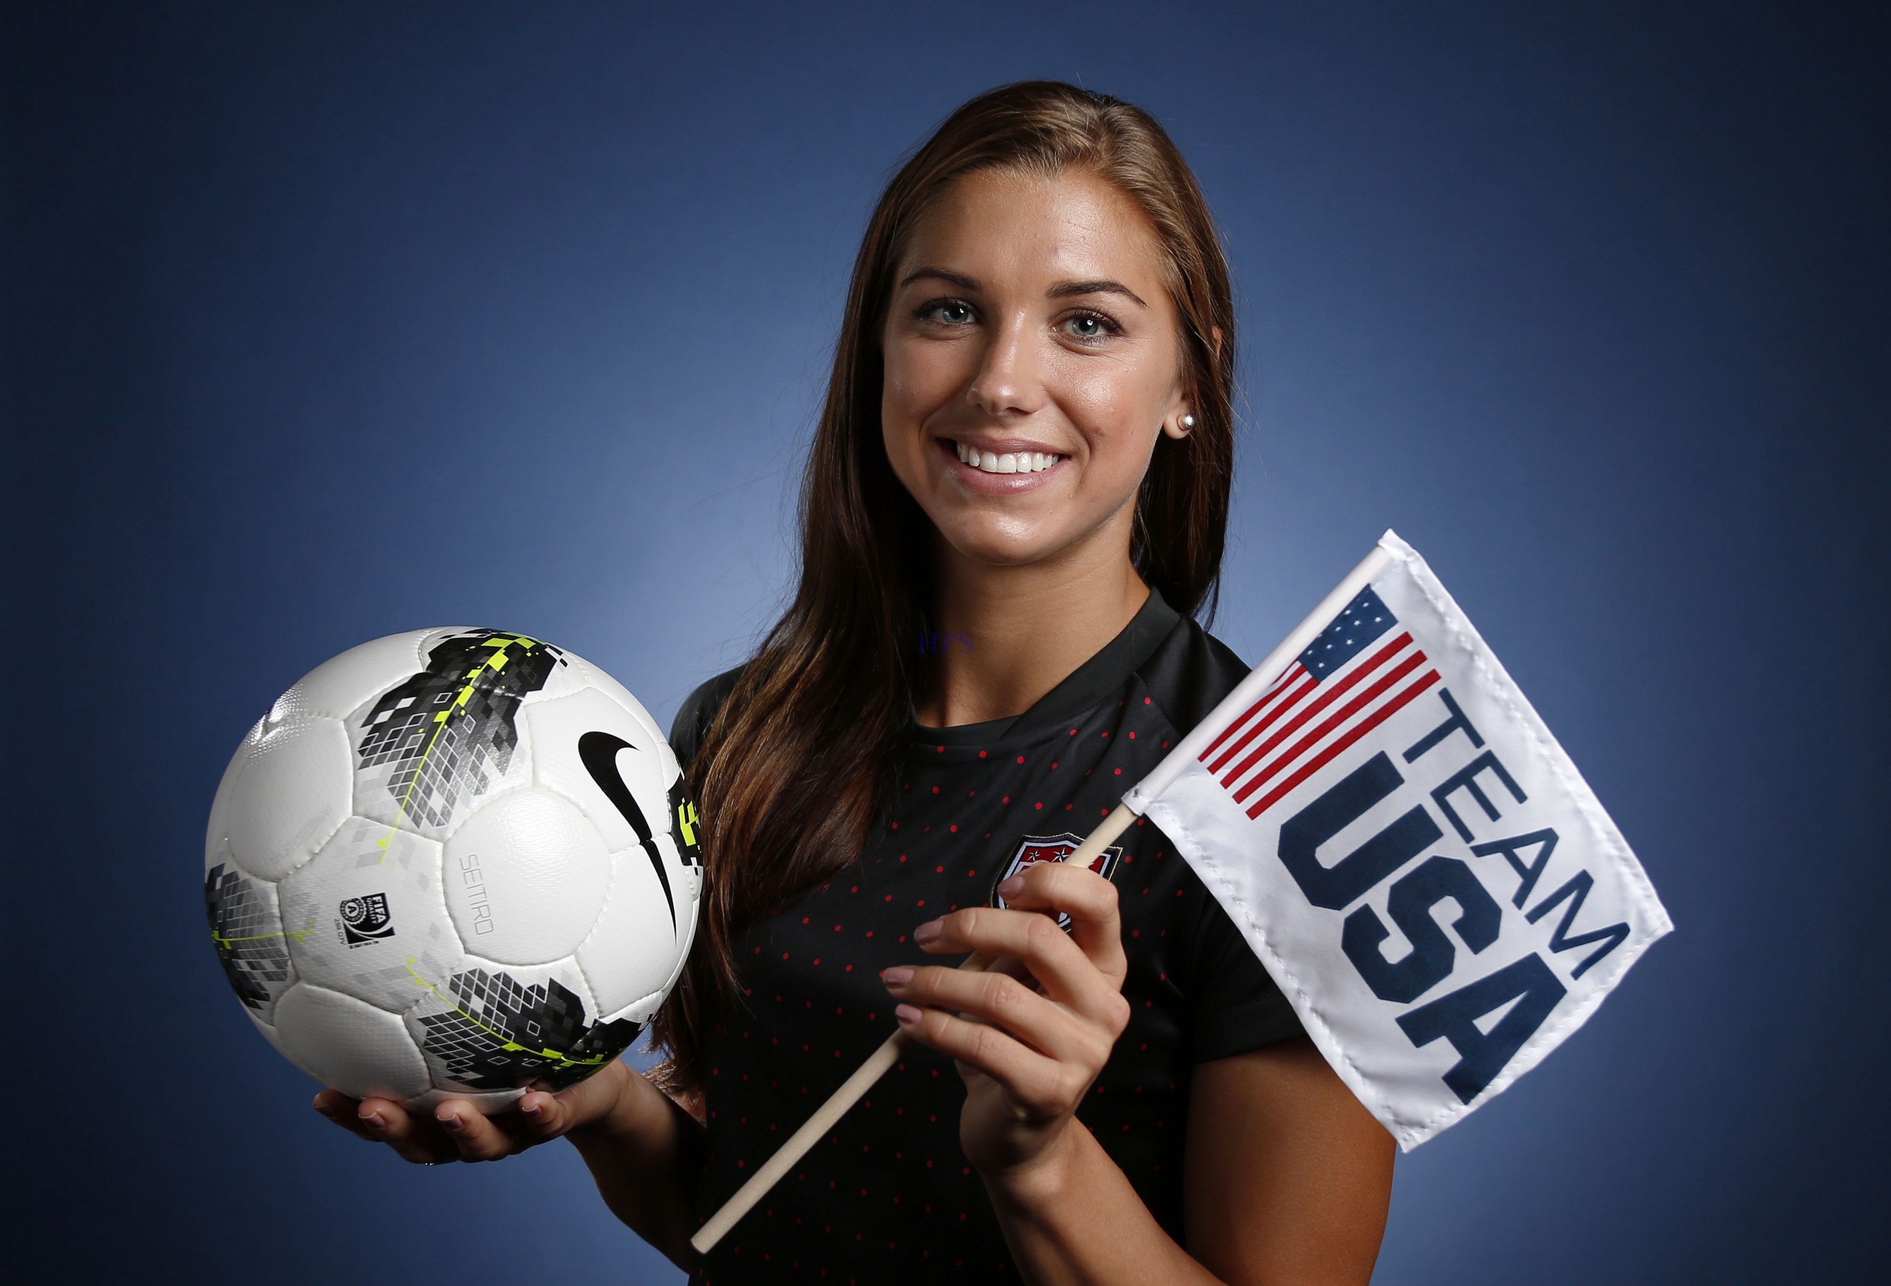
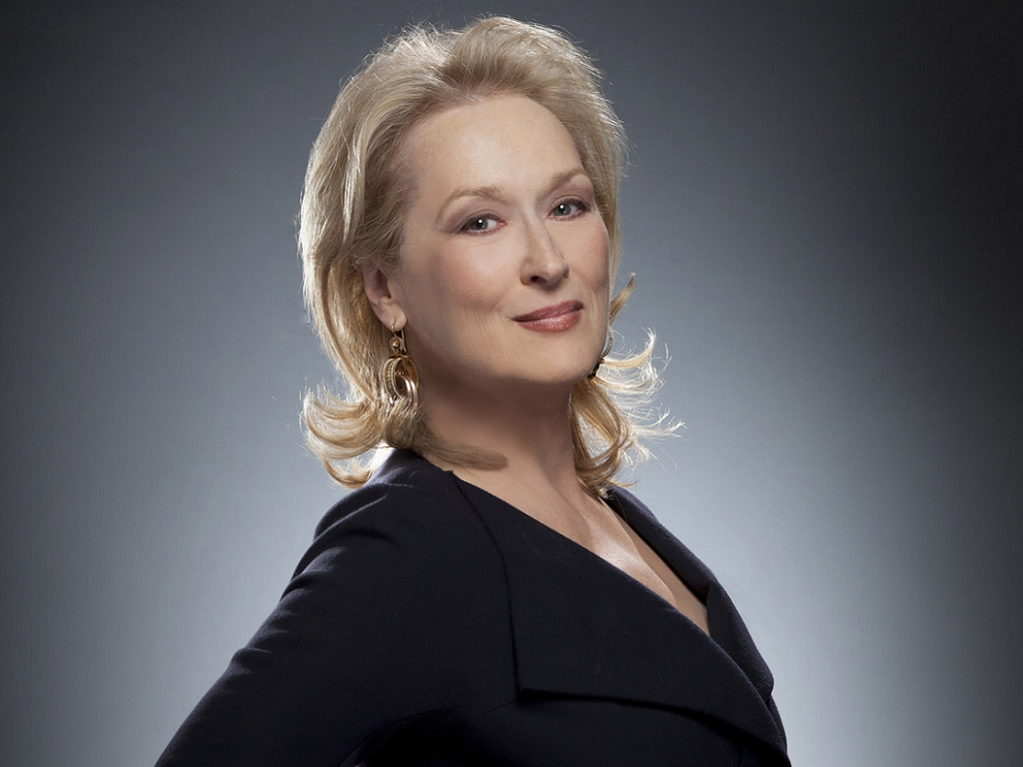
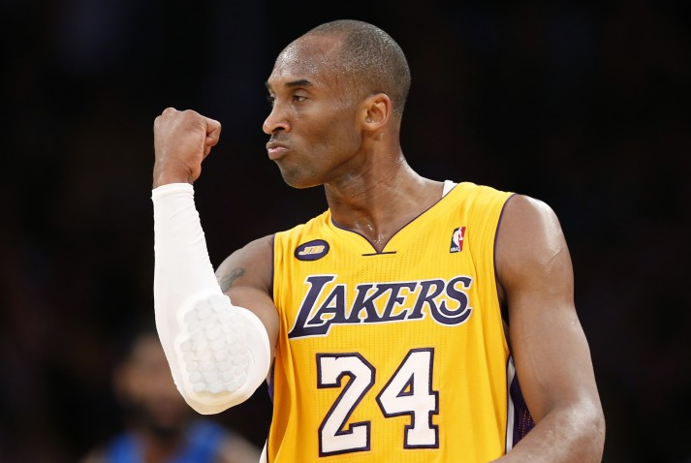
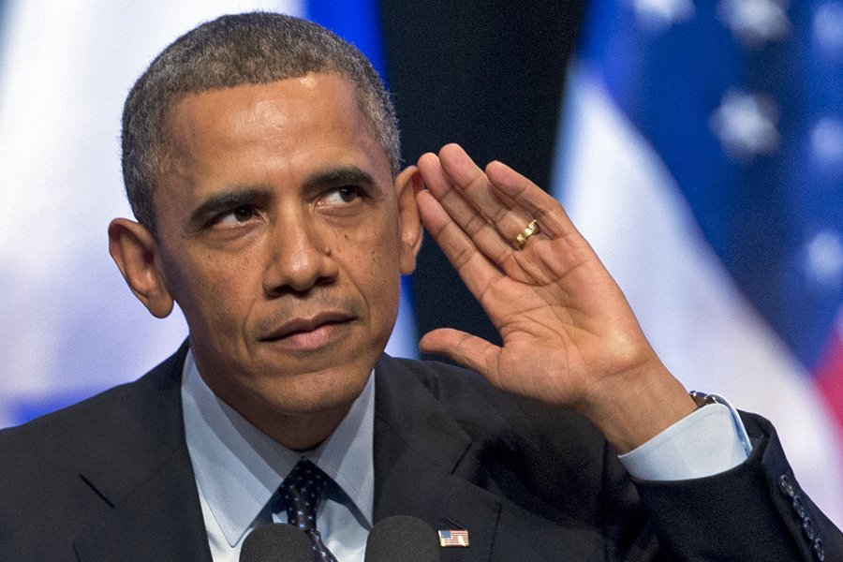

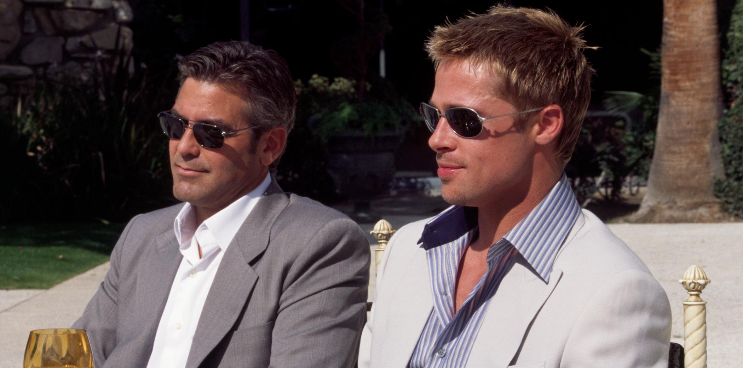
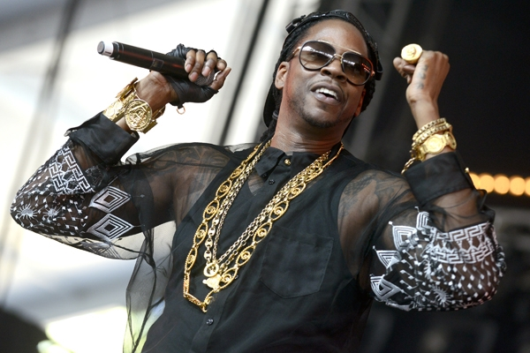
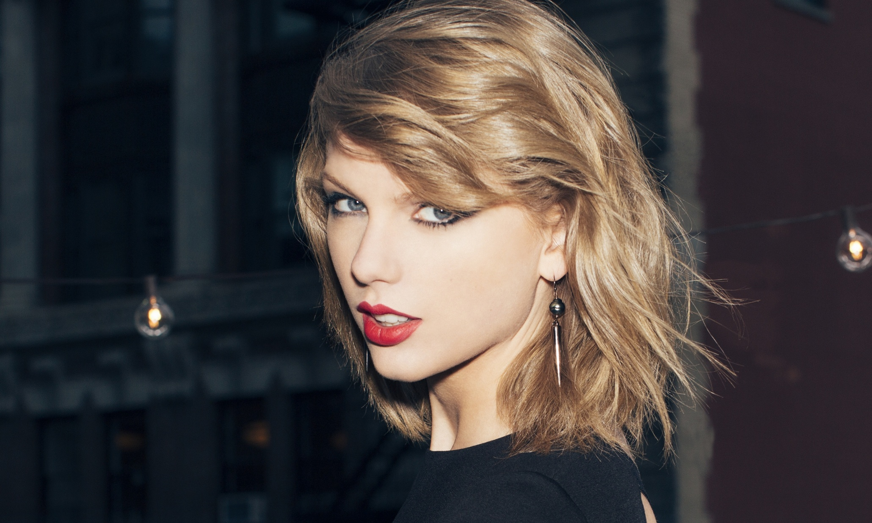
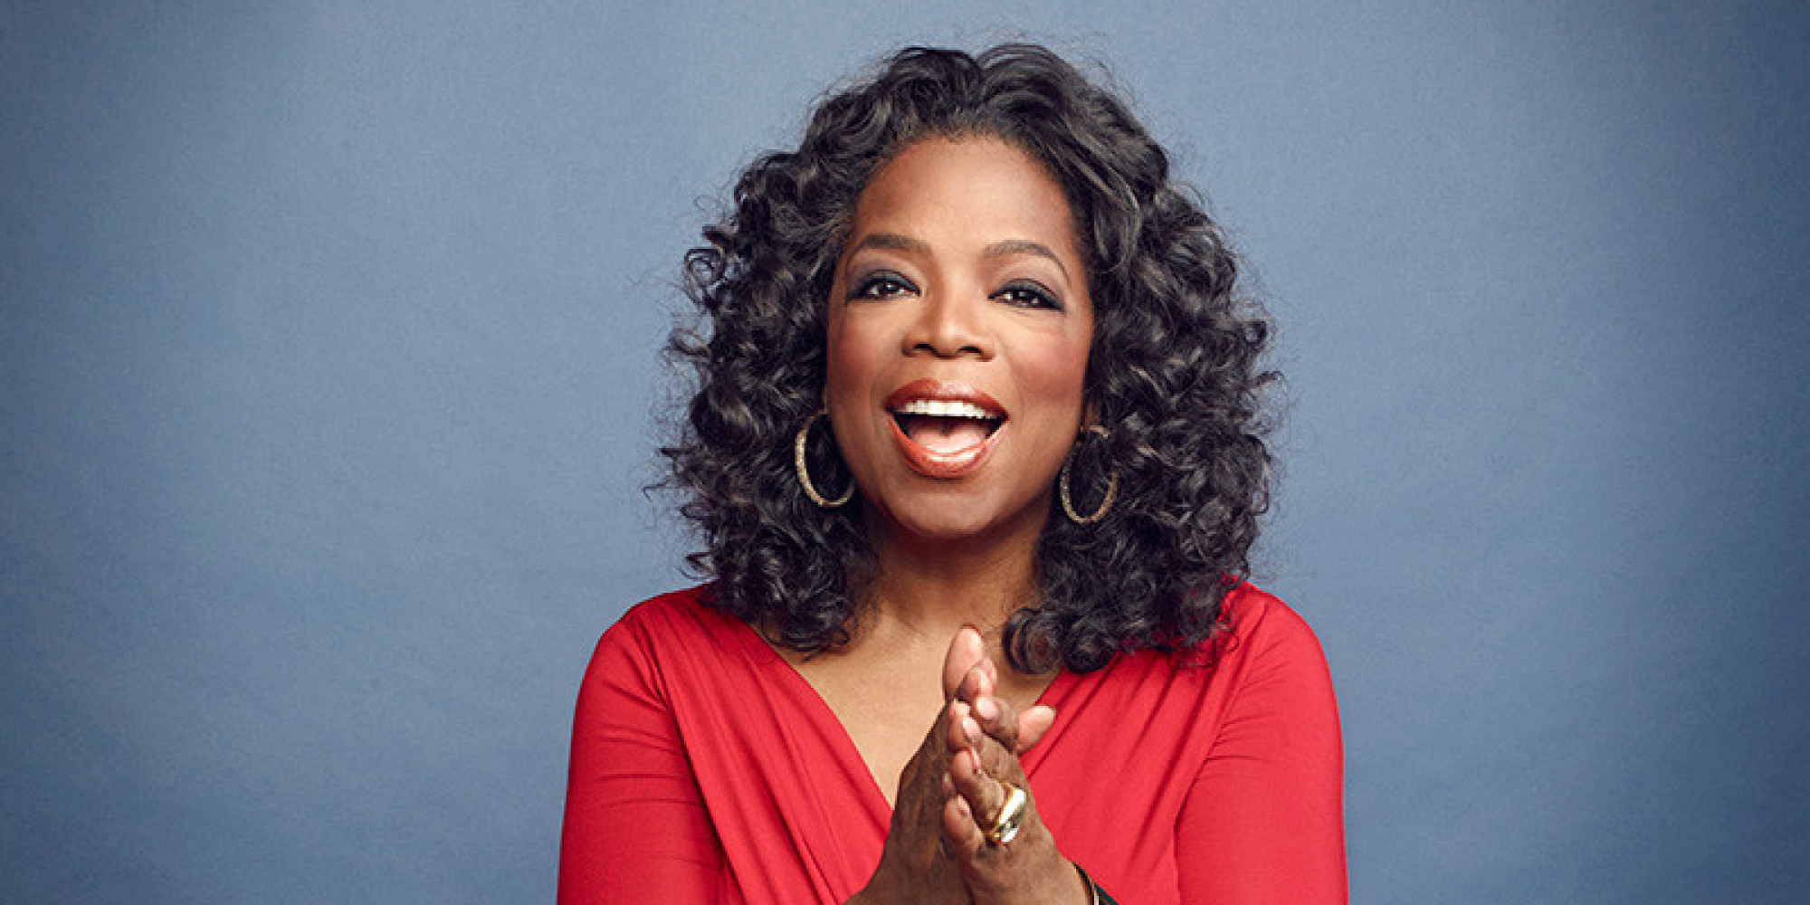
What does confidence look like?
Notes:
Men credits
http://www.power106.com/sites/g/files/exi681/f/styles/large_730/public/article-images-featured/245021-61186.png?itok=HtVctR2f
http://truthinmedia.com/wp-content/uploads/2014/11/Obama-Hand-to-Ear.jpg
https://fortunedotcom.files.wordpress.com/2014/10/452562796.jpg?quality=80&w=1024
http://www.superiorpics.com/movie_pictures/mp/2001_Ocean's_Eleven/george_clooney_brad_pitt_ocean's_eleven_001.jpg
http://www.thestrut.com/wp-content/uploads/2014/02/2chairs.jpg
Women
http://www.amnestyindia.org/wp-content/uploads/2015/06/hillary-clinton-2a.jpg
http://cdn.wp.clicrbs.com.br/codevilla/files/2015/07/Alex-Morgan-18.jpg
http://gazettereview.com/wp-content/uploads/2015/04/Streep.png
http://static.guim.co.uk/sys-images/Guardian/Pix/pictures/2014/8/21/1408618840671/18839f21-608b-4acd-a2aa-a944db3e15e7-2060x1236.jpeg
http://i.huffpost.com/gen/1588485/images/o-OPRAH-facebook.jpg

Slide 8


Who do you know that is confident?
(not arrogant)
What are they like to be around?
Notes:
Could be a rhetorical question or a discussion (depending on time)—whole group, small groups, or pairs

Slide 9

Notes:
Source: https://www.youtube.com/watch?v=2M_quwG4Odo
Video may take several seconds to load

Slide 10
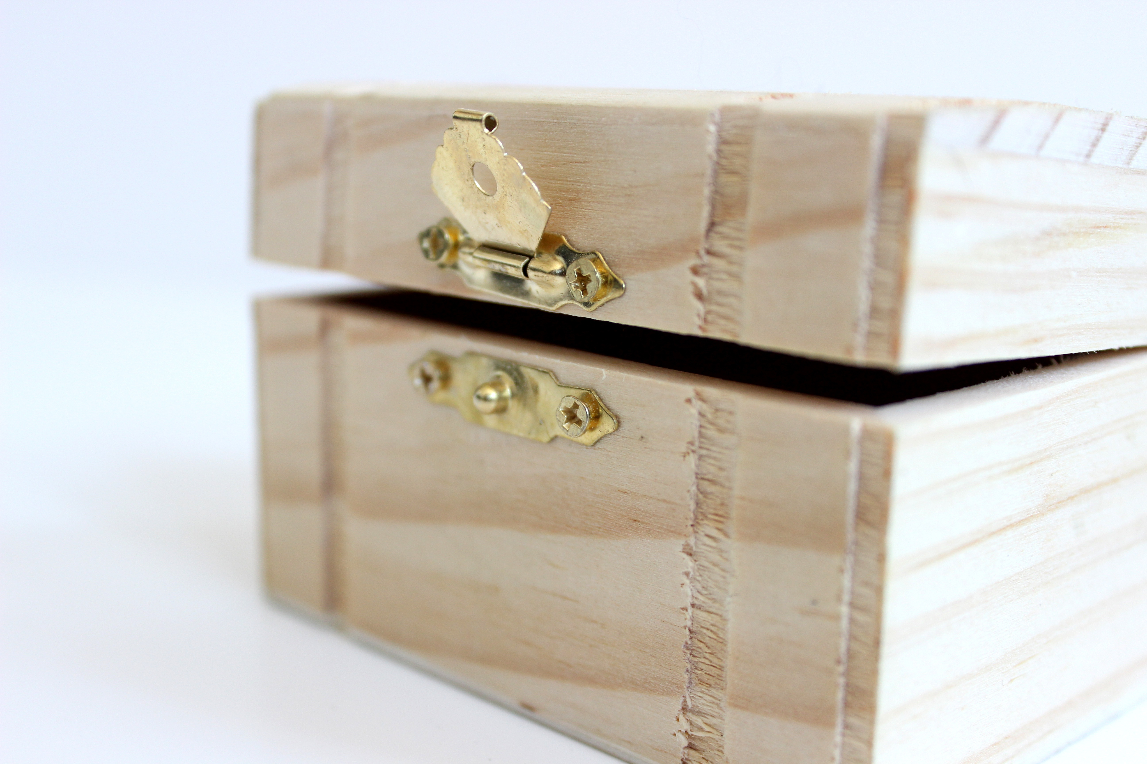
Making confidence accessible
Confidence is usually talked about ethereally (“Gotta have more confidence!”) and is usually not very useful.
To avoid that, we’ll operationalize confidence in two categories:
Domain (what it is)
Development (how to grow it)
Notes:
Image from https://static.pexels.com/photos/221004/pexels-photo-221004.jpeg

Slide 11
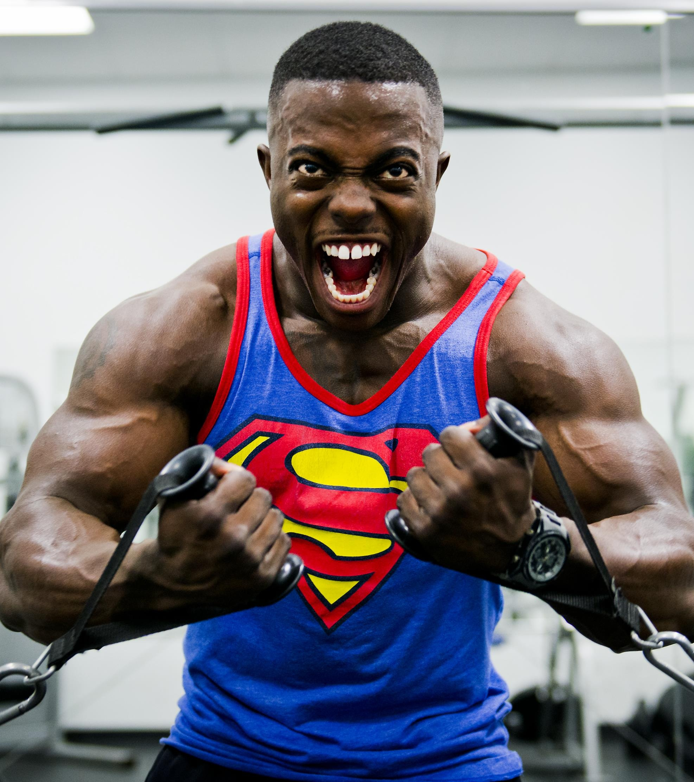
Domain
The area in question; what you have confidence in
Notes:
Image from https://static.pexels.com/photos/38630/bodybuilder-weight-training-stress-38630.jpeg (CC0 license)

Slide 12

Examples
Basketball playing
Contemporary Dance
Drawing
Notes:
Image from https://static.pexels.com/photos/159607/basketball-player-girls-basketball-girl-159607.jpeg (CC0 license)

Slide 13
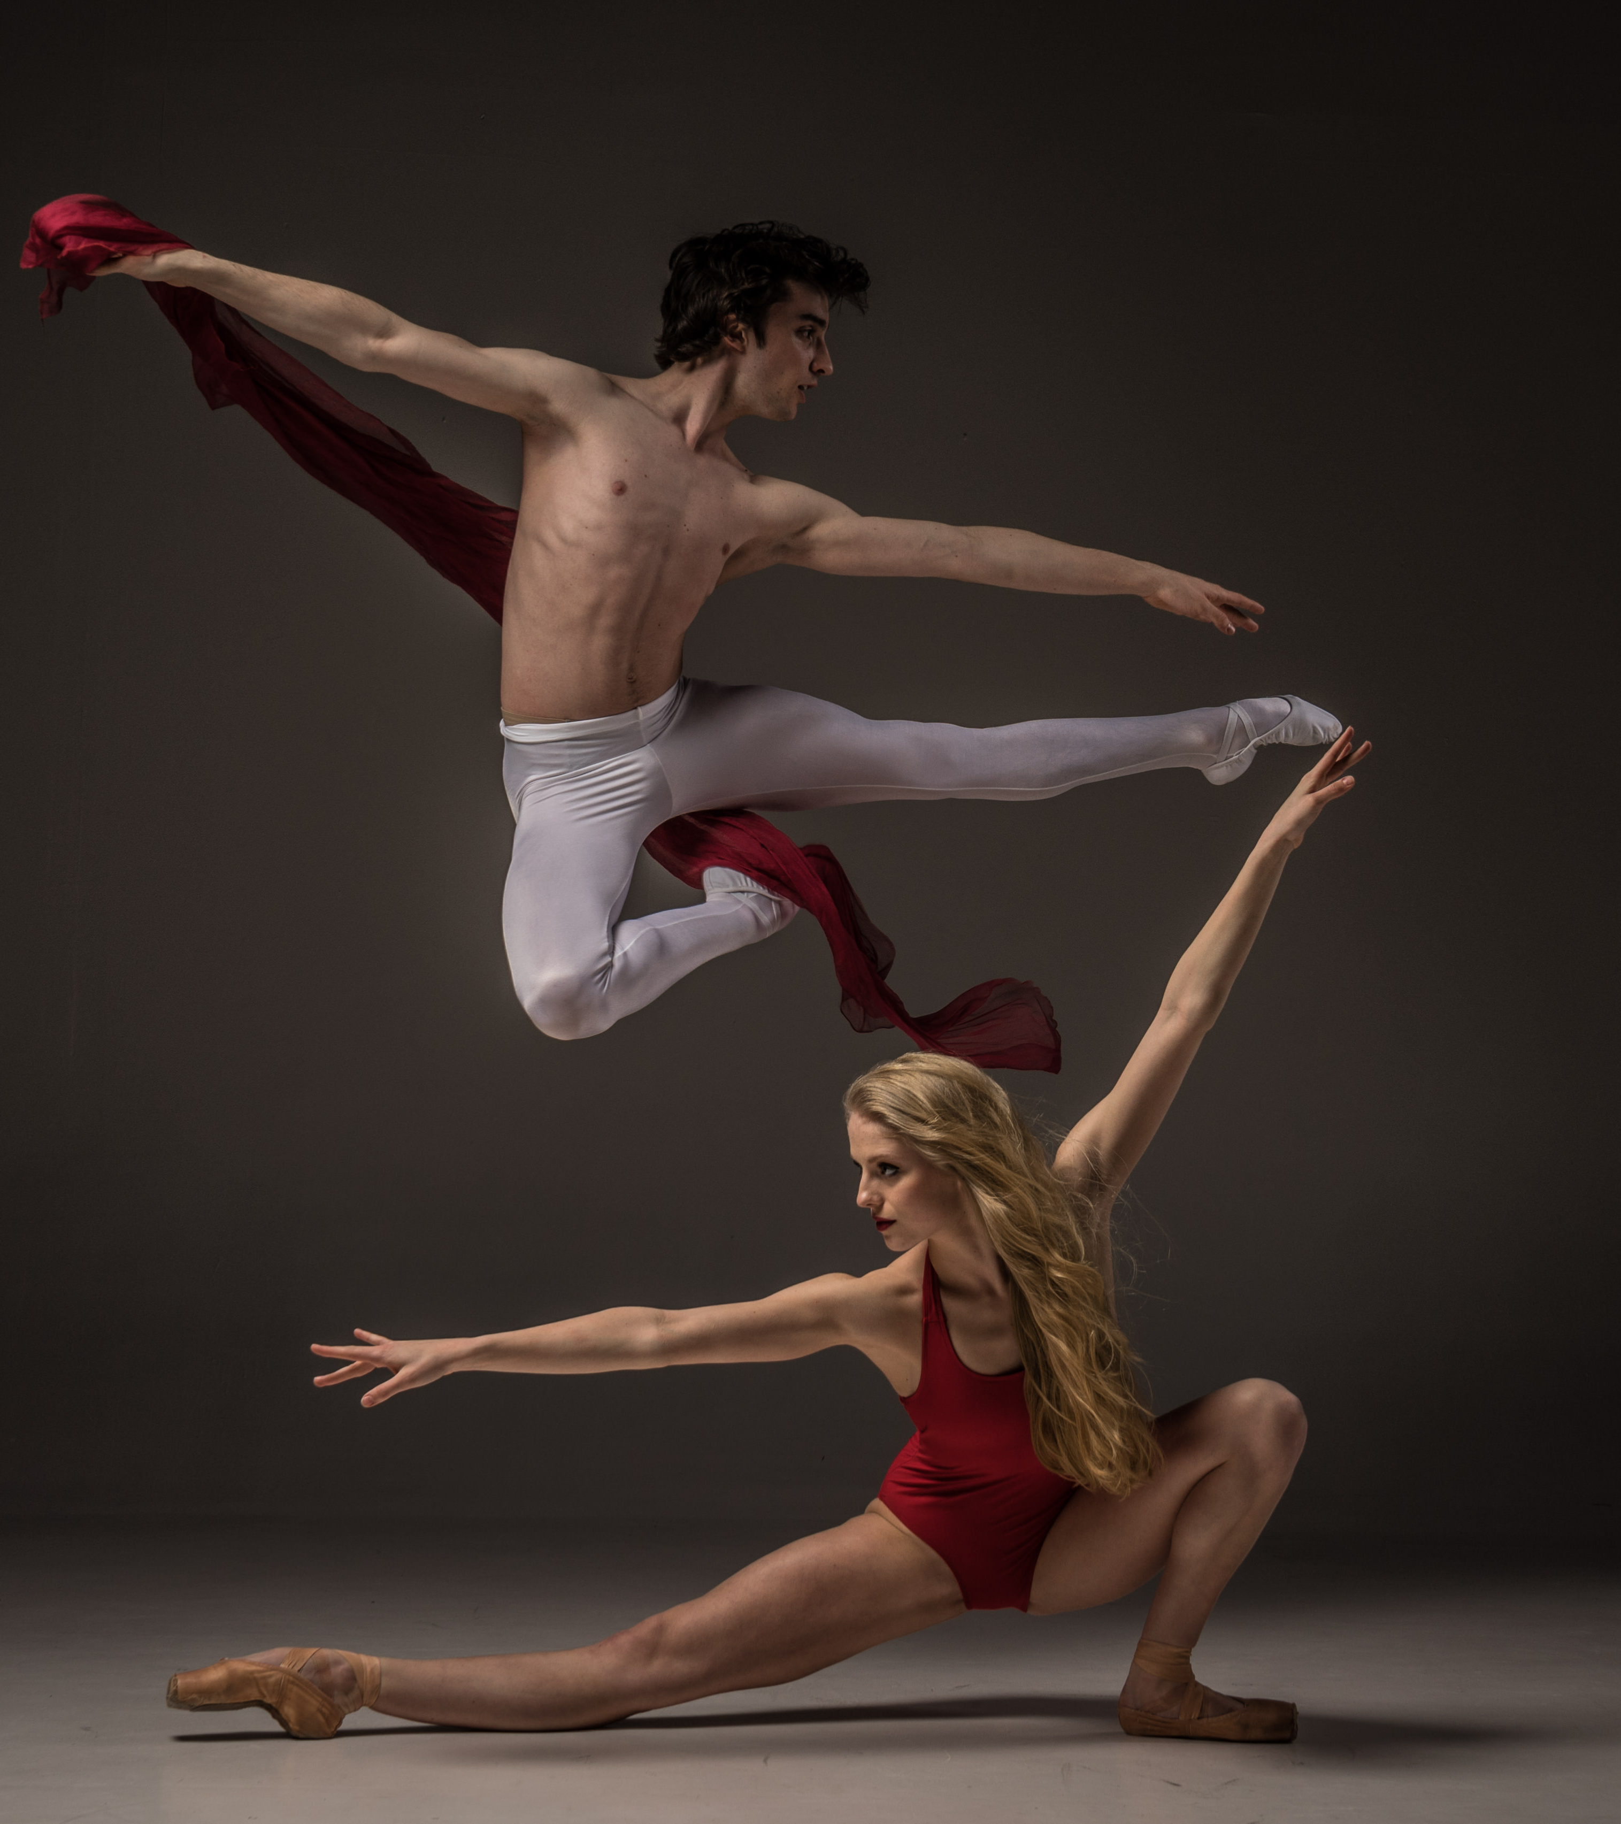
Development
The process by which confidence is increased in a given domain
Notes:
Image from https://static.pexels.com/photos/134694/pexels-photo-134694.jpeg (CC0 license)

Slide 14
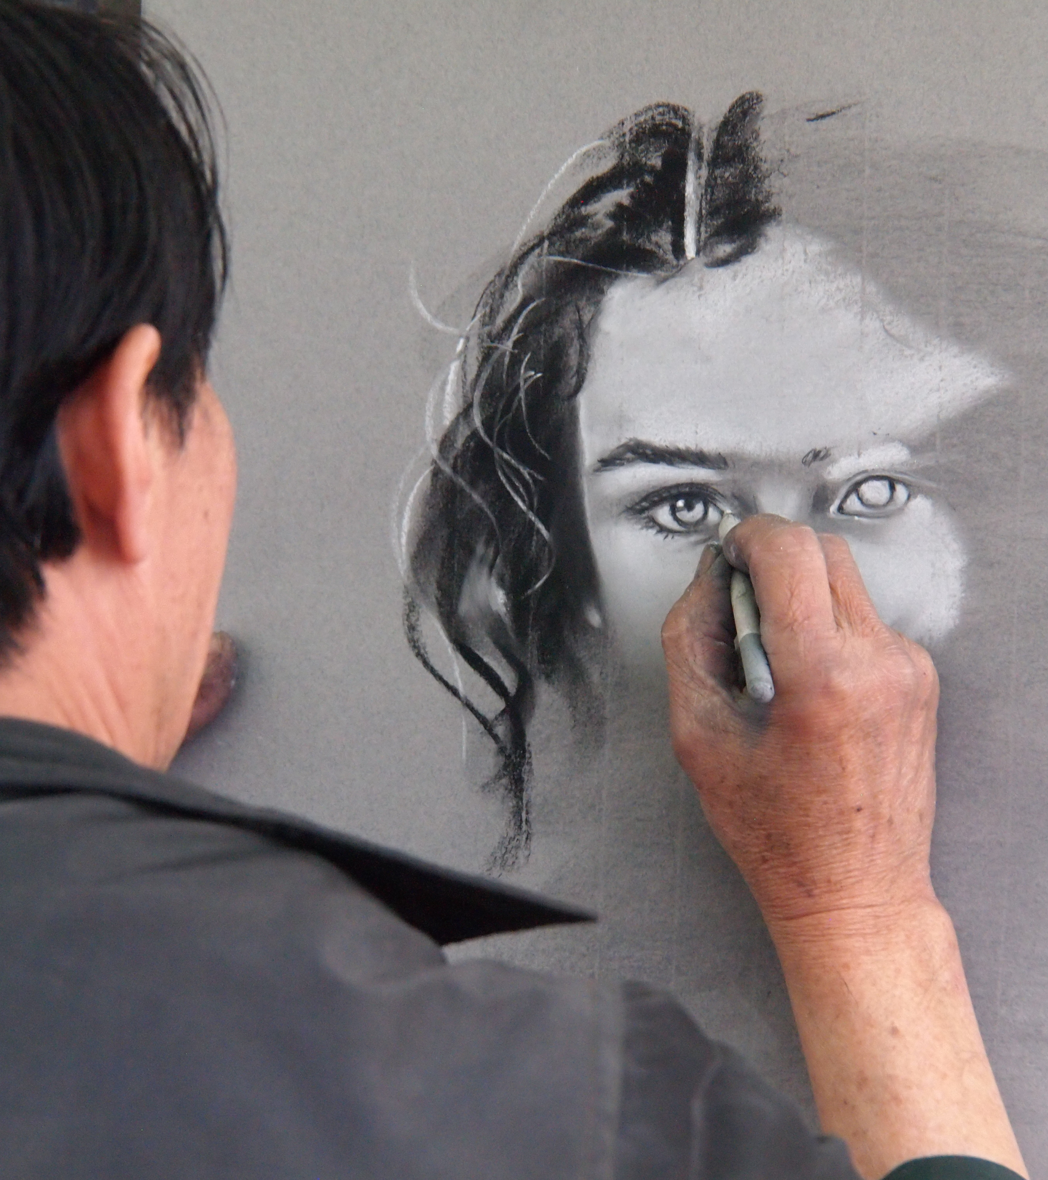
Examples
Basketball
Shoot free-throws
Dribble
Contemporary Dance
Stretch
Watch great dancers
Drawing
Buy an art book
Practice drawing outside
Notes:
Image from https://static.pexels.com/photos/57798/pexels-photo-57798.jpeg (CC0 license)

